Slide 1
GROUP NUMBER TWO (2) BCS
WEB APPLICATIONS DEVELOPMENT
GROUP ASSIGNMENT

Slide 2
PARTICIPANTS
S/N | NAME | REGISTRATION NUMBER
01 | ABDUL R. CHAMBUSO | NIT/BCS/2022/399
02 | ZABRON ISKARI NGWALE | NIT/BCS/2022/394
03 | ELISHA ZABRON MWAISUMO | NIT/BCS/2022/468
04 | KHAMIS SALIM KHAMIS | NIT/BCS/2022/457
05 | DIOUF PETER MARTINE | NIT/BCS/2022/384
06 | NKINDA SHIJA SITTA | NIT/BCS/2022/387
07 | MONICA PASCHAL GEORGE | NIT/BCS/2022/389
08 | RAYSON SIMON TUVANA | NIT/BCS/2022/372
09 | JOSEPH BAHATI KAGANDE | NIT/BCS/2022/403

Slide 3
FUNCTIONALITIES OF THE PROJECT
The CHATWEB system is the system that allows users to communicate in real-time through text-based messaging over the internet. It is accessed through a web browser and can be used for both personal and business purposes. Users can create chat rooms, send direct messages, share files, and collaborate with others in a secure and convenient online environment.
The following are some of the functionalities:
User can register in the system by using phone number and email address, also can create a password.
User can login with the credentials they used when performing registration
User can send and receive messages from the other users
The system admin can register, log in and manage users

Slide 4
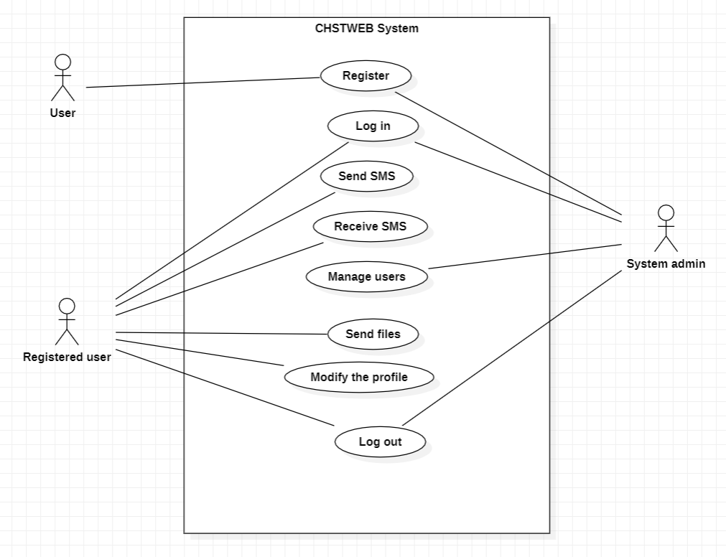
Use case diagram for the chatweb system

